Slide 1
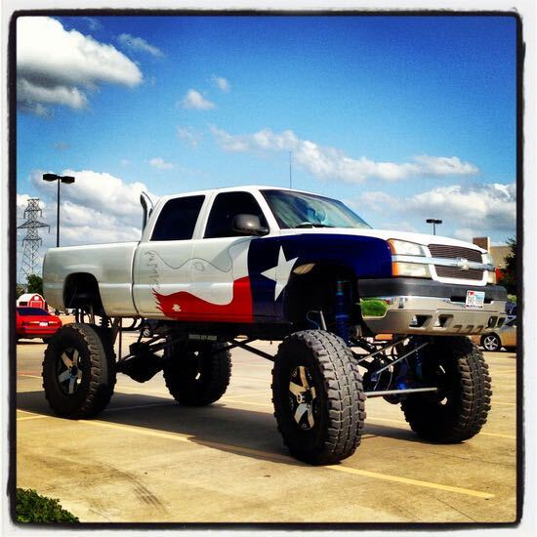
Car Arbitrage Analysis
Just Another Nerdy Team (J.A.N.T.) Consultants
Team members:
Jas Pinglia
Angela Richter
Neil Mendelow
Thuy Nguyen

Slide 2
Agenda
Executive Summary
Methodology
Client Requirements & Assumptions
Data Collection, Preparation, & Exploration
Analysis
Recommendations
Notes:
Engagement is conceptual study of truck arbitrage

Slide 3
Executive Summary
Gen Z & Co., a company headquartered in Texas, has engaged JANT Consultants to advise the extent and viability of work truck arbitrage due to oil field demand and ongoing chip shortage. Gen Z has tasked JANT to leverage our financial programming skills to address the following key considerations:
Key Considerations:
Are there truck arbitrage opportunities for re-sale in Texas?
What are the best arbitrage opportunities by location?
Which specific manufacturers offer the greatest arbitrage margins?
Notes:
Engagement is conceptual study of truck arbitrage

Slide 4
Methodology
Client Requirements & Assumptions
1
Collect data
- Craigslist as data source¹
2
Prepare data
- Utilize Jupyter lab
- Clean & filter data for client requirements
3
Analyze data
1) Profitability
2) Narrow focus by location
3) Narrow focus by manufacturer
4
Deliver Findings & Recommendations
₁
Reese, A. (2021, May 6). Used cars dataset. Kaggle. Retrieved February 5, 2022, from https://www.kaggle.com/austinreese/craigslist-carstrucks-data?select=vehicles.csv

Slide 5
Client Requirements & Assumptions
Client requirements
Year 2015 & newer
Work truck
Clean title
“Good” to “Excellent” condition
Excludes HI & AK
Max odometer reading 75k
Assumptions
Pricing data from Craigslist is indicative of current market value
Freight/Transaction costs = $2,099
Taxes excluded
Truck demand in Texas is greater than demand in rest of US
Notes:
Cite 599 https://worldpopulationreview.com/state-rankings/car-dealer-fees-by-state

Slide 6
Data Collection, Exploration, & Cleanup Process
Data Collection
Exploration
Cleanup
₁
Reese, A. (2021, May 6). Used cars dataset. Kaggle. Retrieved February 5, 2022, from https://www.kaggle.com/austinreese/craigslist-carstrucks-data?select=vehicles.csv
Notes:
Craigslist = proof of concept

Slide 7
Data Collection, Exploration, & Cleanup Process
Import dataset into Jupyter Lab for data manipulation
Review the data for duplicated values, and drop them if necessary.
Convert columns that appear to be numerical values to the data type of a float or integer.
Drop unnecessary columns.
Create a unique ‘description’ identifier by concatenating columns: year, make, model.
Drop `NaN`, or missing, values in the DataFrame.
Notes:
**Filter Manufacturers
**Assign average values to Texas work trucks

Slide 8
Approach
Determine average pricing in Texas by vehicle
Compare to national listings and calculate arbitrage spread
Perform general profitability analysis
Calculate net profit after transaction/freight costs
Narrow focus by selecting 3 locations
Narrow focus by manufacturer
Notes:
Outline – outlined steps
Collect – Craigslist, CSV, Git LFS
Prepare – Clean data, create filters & functions to manipulate data
Analysis – Apply filters and functions to sliced dataframes; [Determine existence of arbitrage opportunities, Where are they, which manufacturer is most lucrative?] – examined via dataframe stats and plots presented herein

Slide 9
99 problems
Data set too large for git hub
Carvana/users postings multiple listings across US for the same vehicle
Car notes listed as price – created filter to eliminate sales price less than $2k
$15k capped spread to eliminate unrealistic sales prices
Notes:
Outline – outlined steps
Collect – Craigslist, CSV, Git LFS
Prepare – Clean data, create filters & functions to manipulate data
Analysis – Apply filters and functions to sliced dataframes; [Determine existence of arbitrage opportunities, Where are they, which manufacturer is most lucrative?] – examined via dataframe stats and plots presented herein

Slide 10


Are there truck arbitrage opportunities for re-sale in Texas?
This Photo by Unknown Author is licensed under CC BY-SA
This Photo by Unknown Author is licensed under CC BY-NC

Slide 11
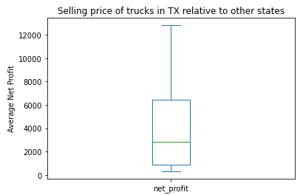
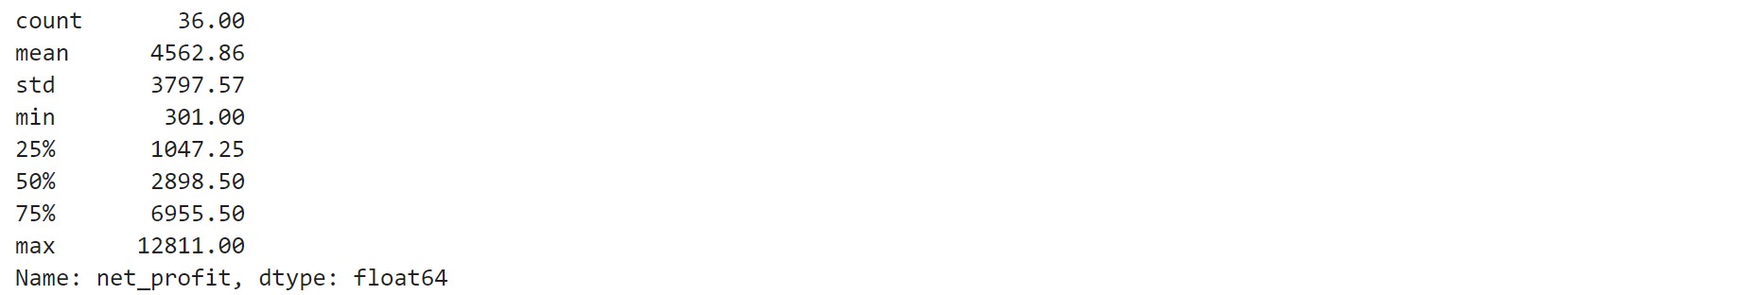
Arbitrage Opportunities at a Glance Distribution
Notes:
Label
Insert stat pic

Slide 12
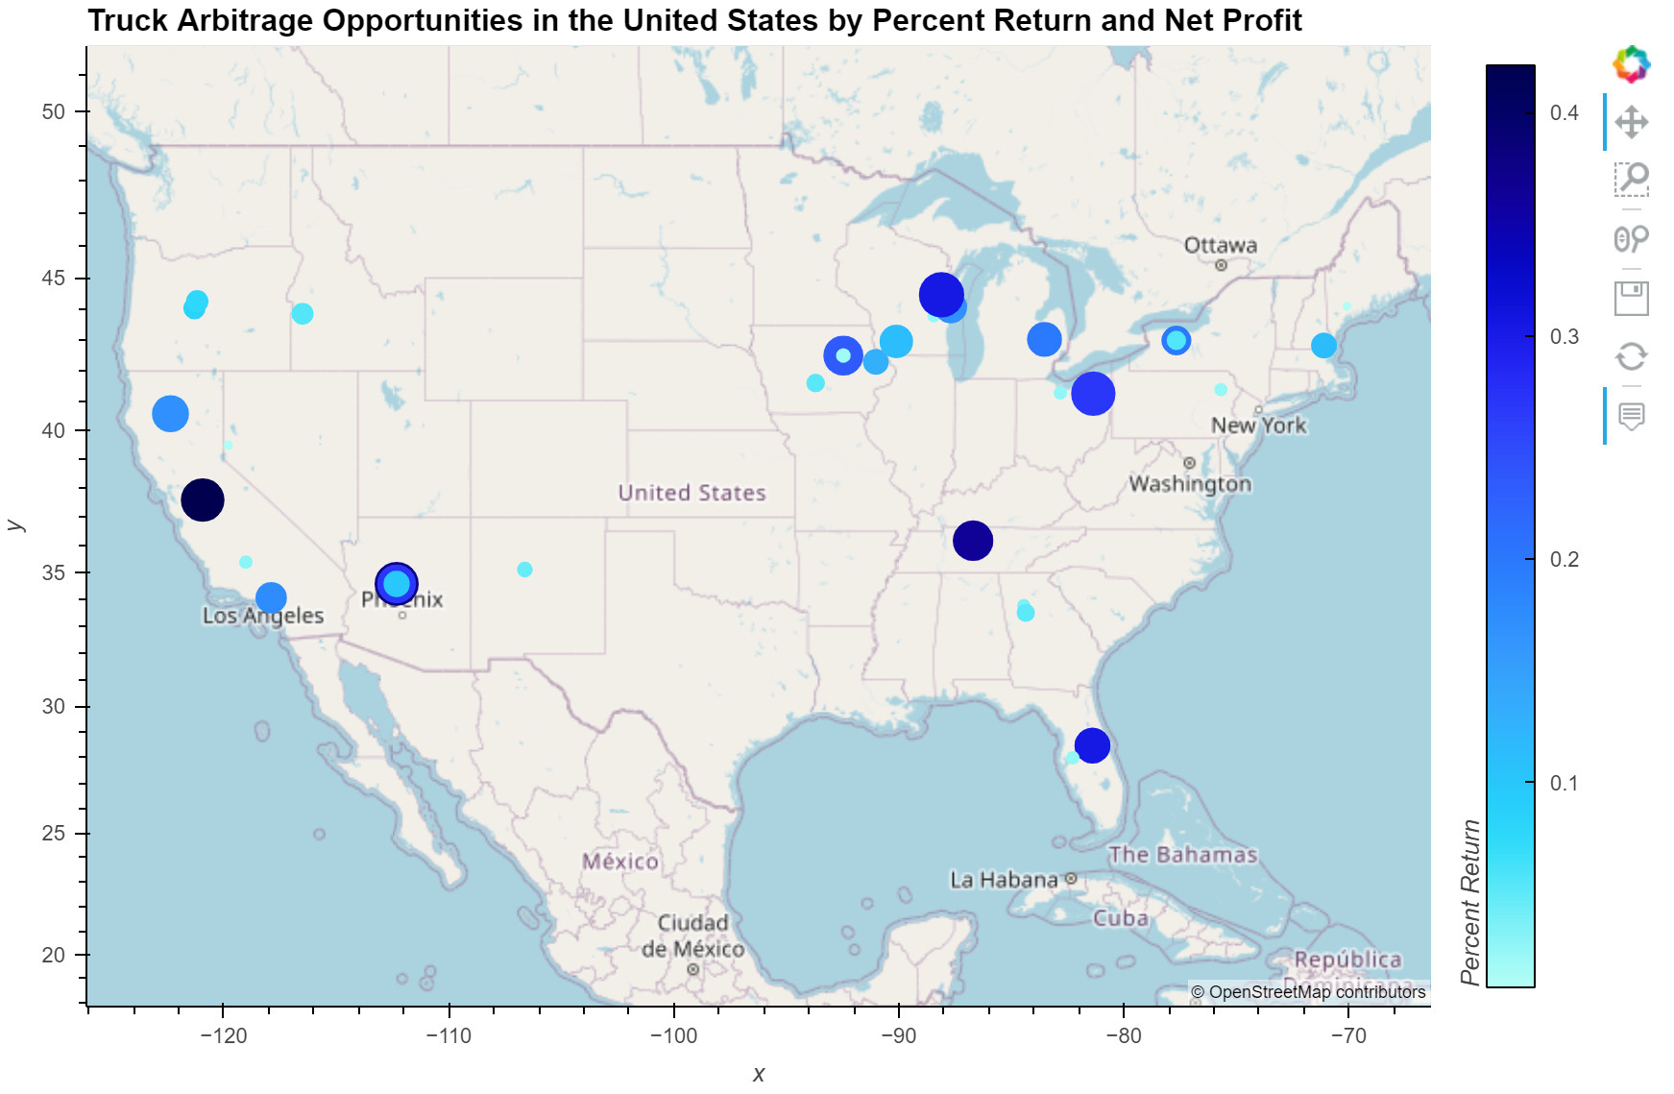
Arbitrage Opportunities at a Glance
Notes:
Add hover box

Slide 13
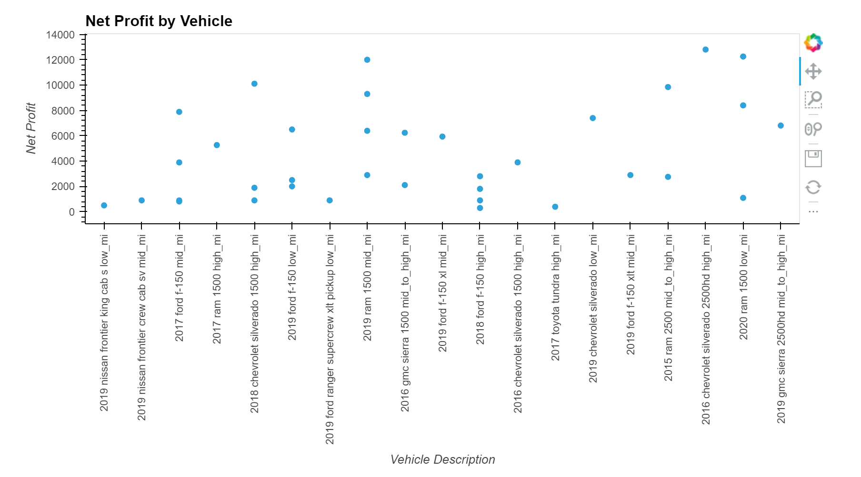
Arbitrage Opportunities at a Glance Net Profit by Vehicle
Notes:
Insert new scatter net profit

Slide 14
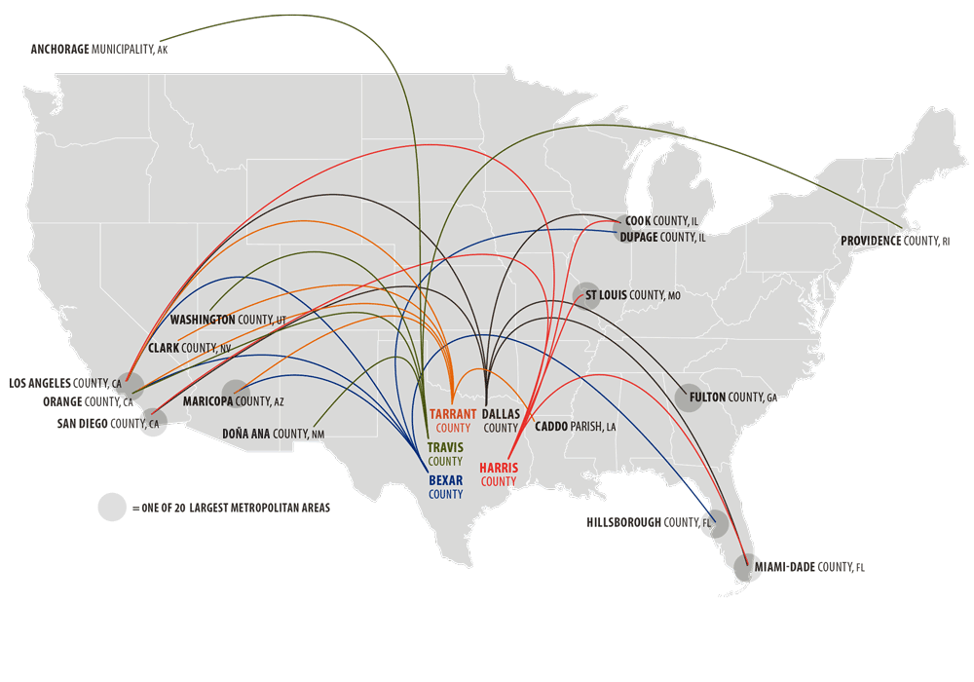
What are the best arbitrage opportunities by location?

Slide 15
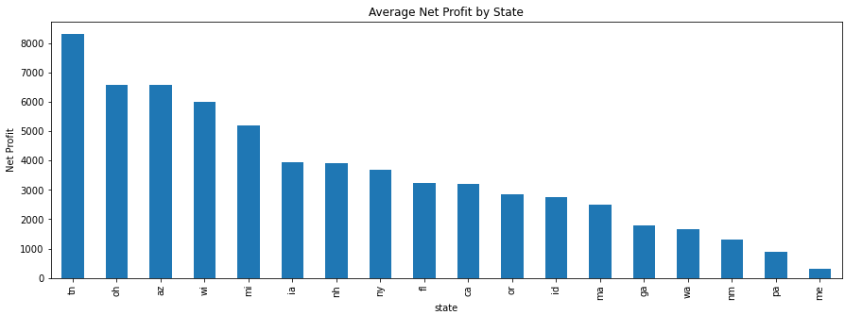
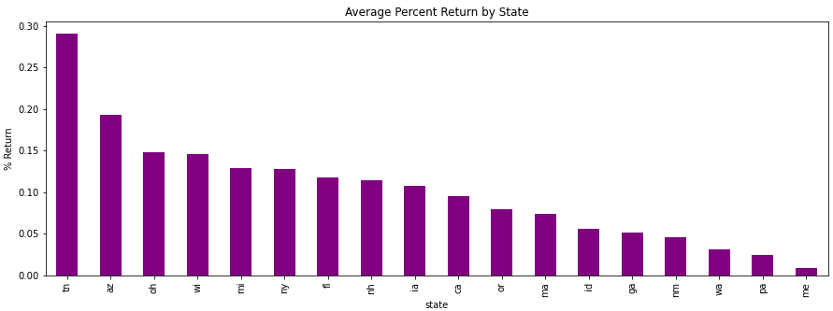
Average Net Profit by State
Notes:
Avg of total profit; descending
GA
CA
MI

Slide 16
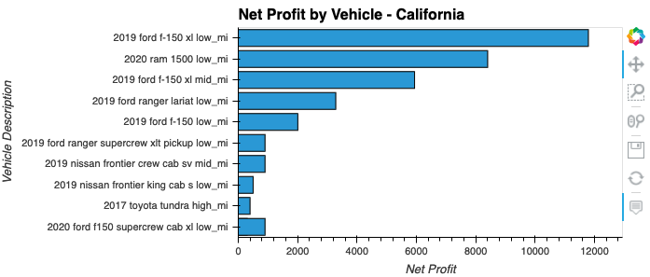
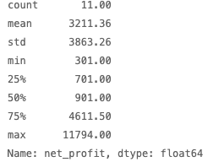
Net Profit by Vehicle : CA
Notes:
Avg of total profit; descending
GA
CA
MI

Slide 17
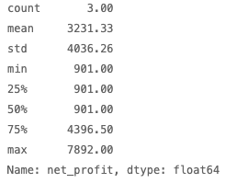
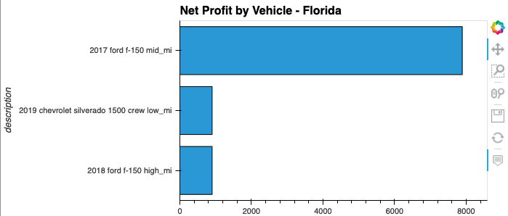
Net Profit by Vehicle : FL
Notes:
Avg of total profit; descending
GA
CA
MI

Slide 18
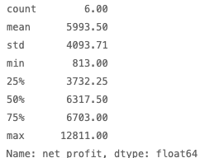
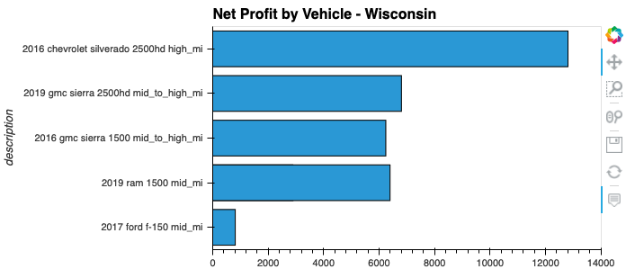
Net Profit by Vehicle: WI
Notes:
Avg of total profit; descending
GA
CA
MI

Slide 19
Which manufacturers deliver the greatest arbitrage margins?
Notes:
Engagement is conceptual study of truck arbitrage
Jas

Slide 20
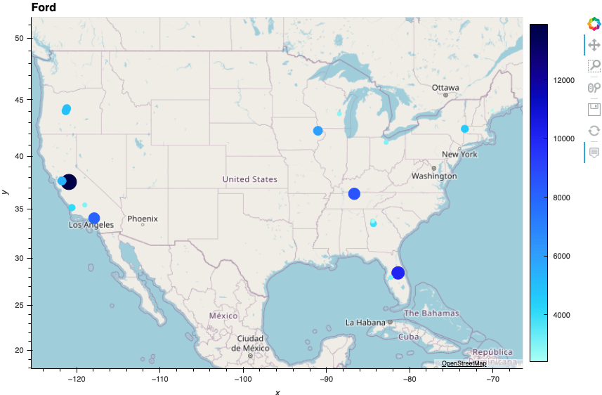
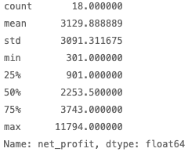
Ford
Notes:
Avg profit by manufactures

Slide 21
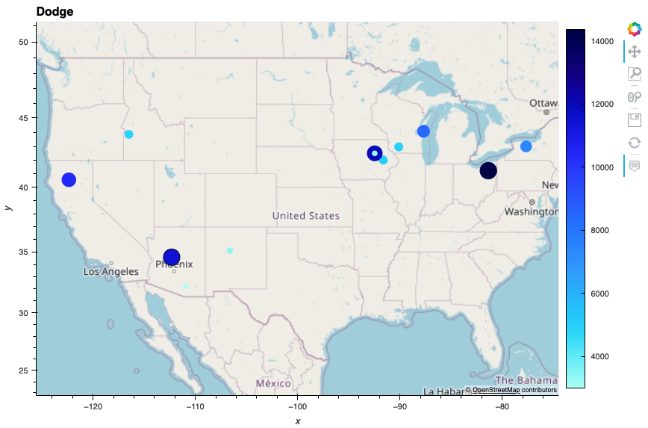
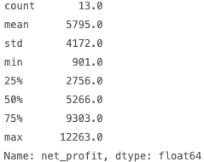
Dodge
Notes:
Avg profit by manufactures

Slide 22
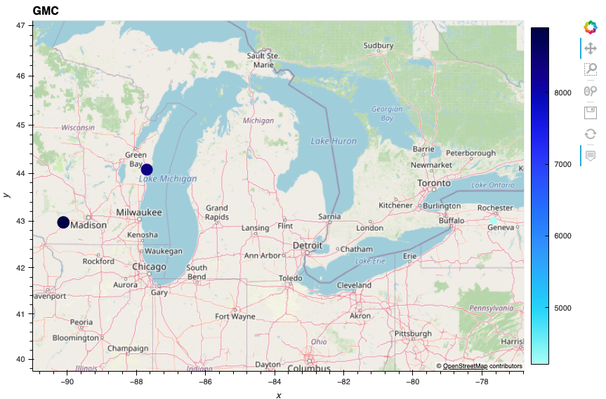
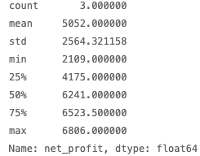
GMC
Notes:
Avg profit by manufactures

Slide 23
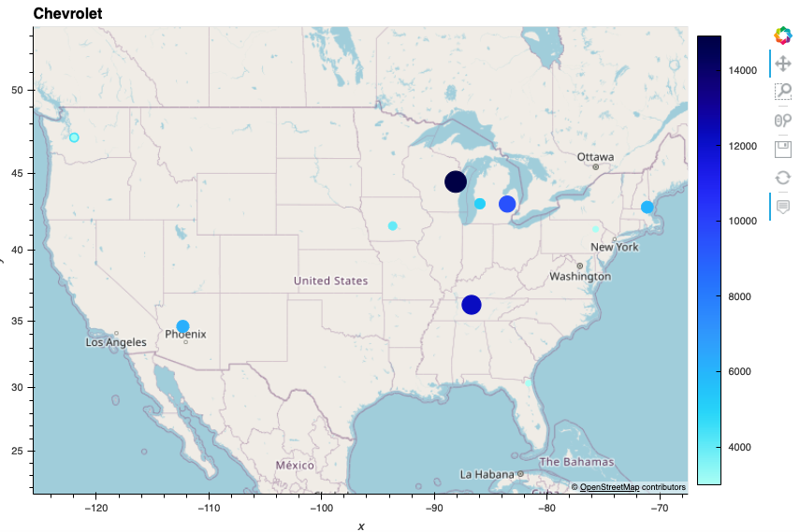
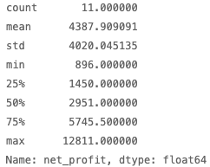
Chevrolet
Notes:
Avg profit by manufactures

Slide 24
Conclusions, Recommendations & Future Considerations
Are there truck arbitrage opportunities for re-sale in Texas?
What are the best arbitrage opportunities by location?
Which specific manufacturers offer the greatest arbitrage margins?

Slide 25
Q & A

Slide 26
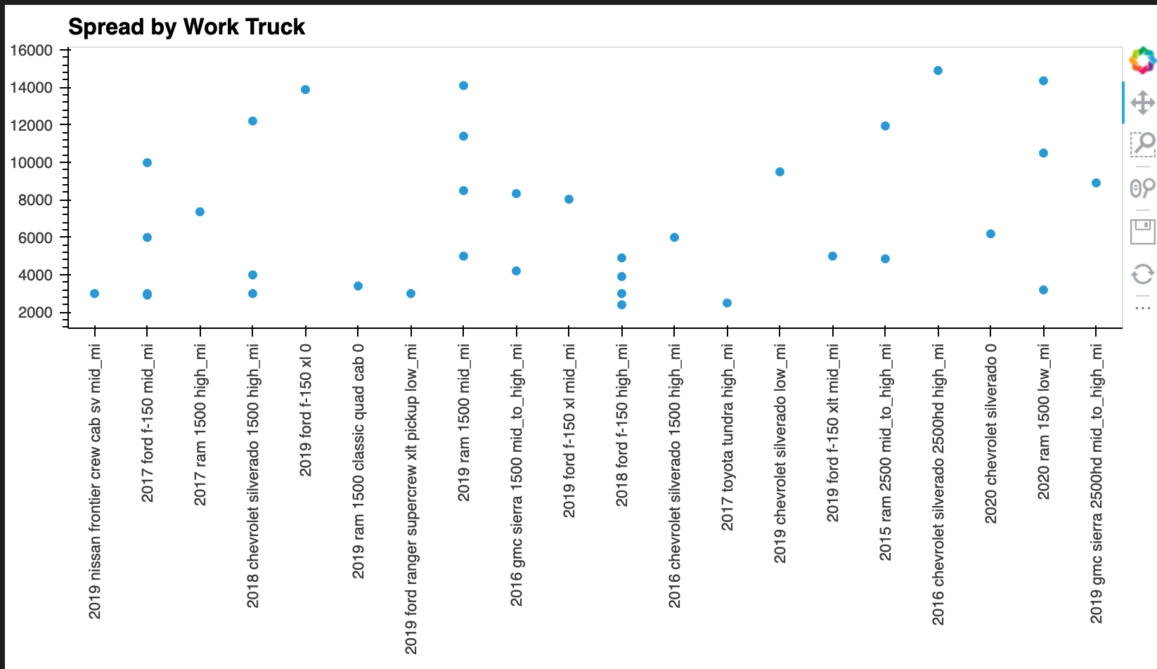
Spread by Work Truck

Slide 27
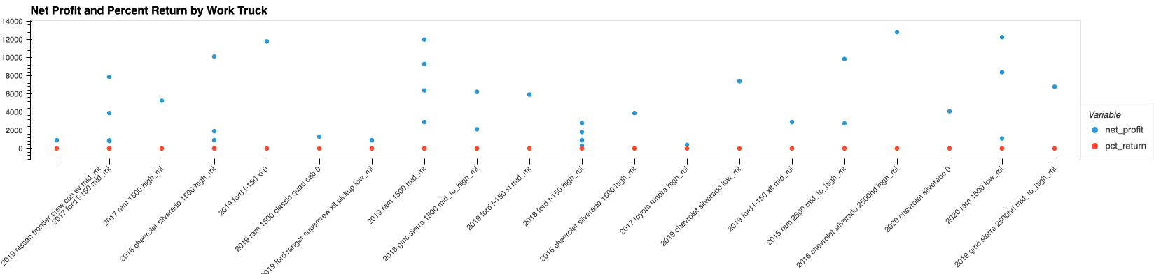
Most Profitable Manufacturers
Notes:
Avg profit by manufactures

